Slide 1
3D Image Segmentation and Quantification of Lysosomes
2nd meeting 15/09/2025

Slide 2
OUTPUT
Metrics-lysosomes
Segmentation
DATASETS
Size
Number of lysosomes.
Localization of lysosomes in the cell.

Slide 3
How we measure lysosome size?
We look for bright little spots (lysosomes) at several zoom levels.
For each spot, the computer finds the zoom level that fits it best; that number (called sigma) is basically the spot’s scale.
We turn that scale into a radius with a fixed conversion (about “radius ≈ 1.7 × scale” in 3D).
Then: diameter = 2 × radius, and volume = “how much space a little sphere with that radius would take.”
Bottom line: find spot → get its scale → convert to radius → compute diameter & volume.
“We detect bright dots, grab their best-fit size, convert that to radius, then get diameter and volume.”

Slide 4
How we find the cells (what the filters do)?
Think of the image like a dark map with thin, bright roads (neurites) and brighter neighborhoods (cell bodies).
The Meijering filter acts like a highlighter for thin roads—it lights up neurite-like lines.
Local thresholding lets each small neighborhood auto-decide what is “cell” vs “background,” so changing brightness doesn’t fool it.
After that, we do a quick cleanup: remove tiny specks and close small gaps so the cells look continuous.
“A road-highlighter filter plus local auto-thresholding finds cells even when brightness changes.”

Slide 5
“Topographic map” (how we split cells and assign territories)
Imagine the image as a landscape: bright areas are hills, dark areas are valleys.
We drop seeds inside each cell body (the safe centers).
Then we “flood” from those seeds until waters meet—the meeting lines become the borders between cells (this is the watershed idea).
Now every pixel belongs to one cell territory, so each lysosome can be labeled “inside cell #X” or “outside.”
“Treat brightness as terrain; flood from each cell center so borders form where floods meet.”

Slide 6
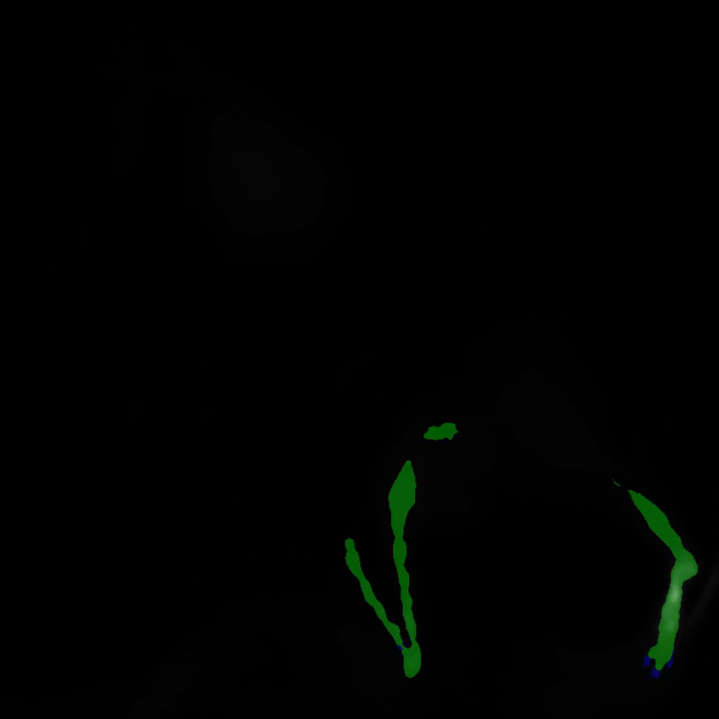
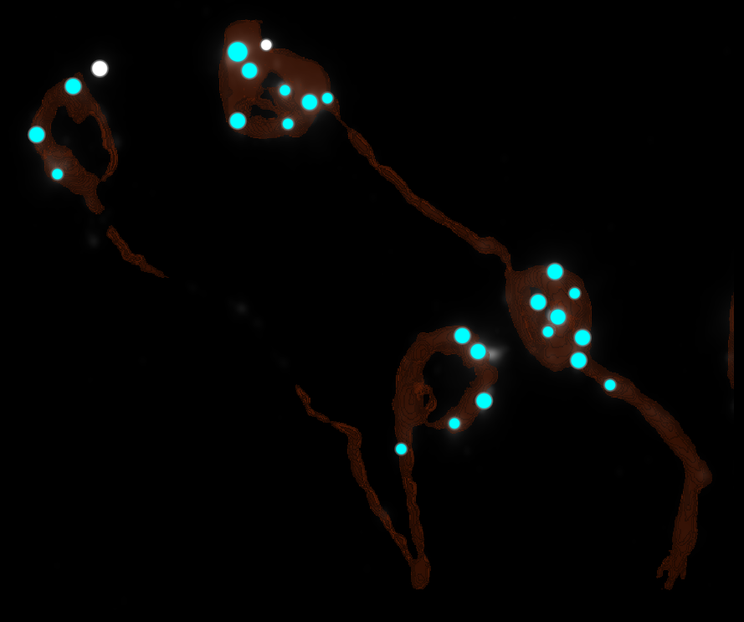
SEGMENTATION

Slide 7
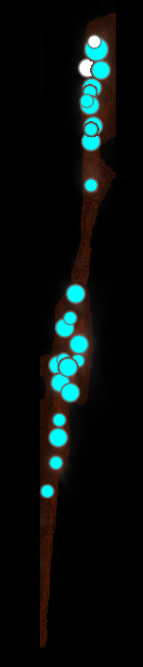
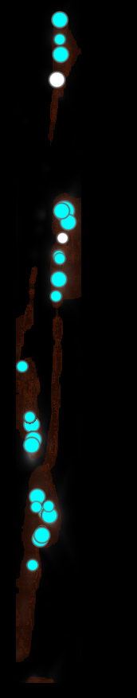
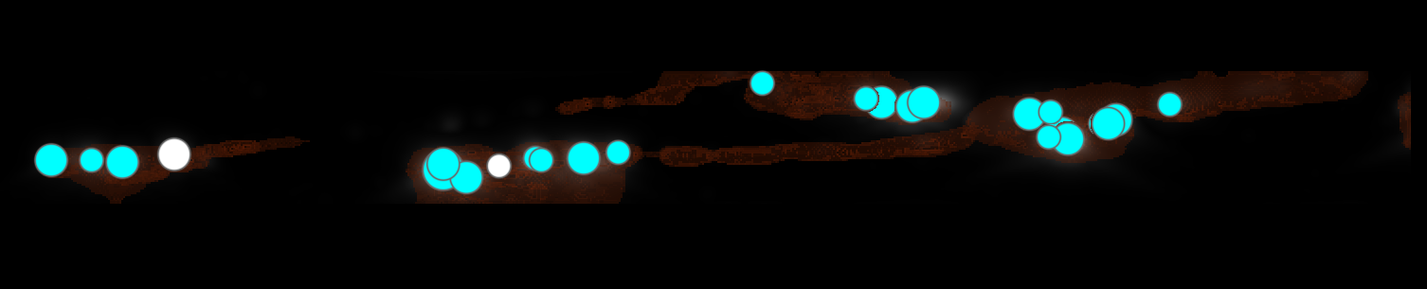
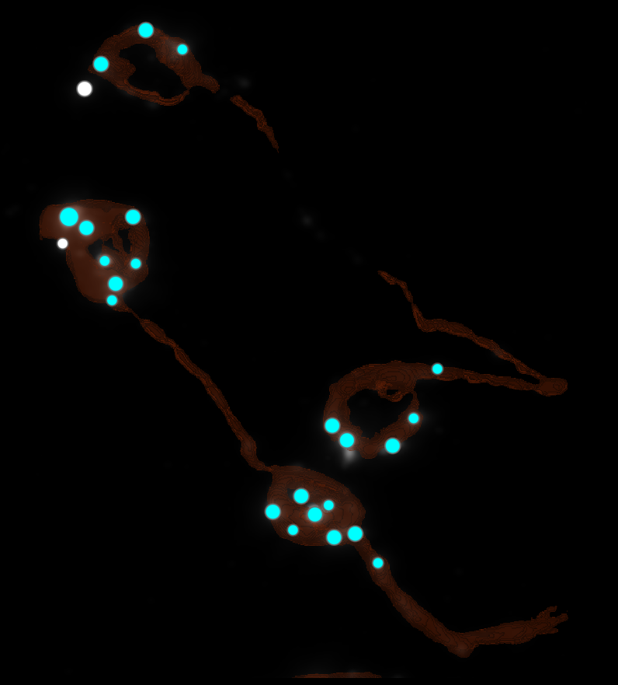
Topographic map

Slide 8
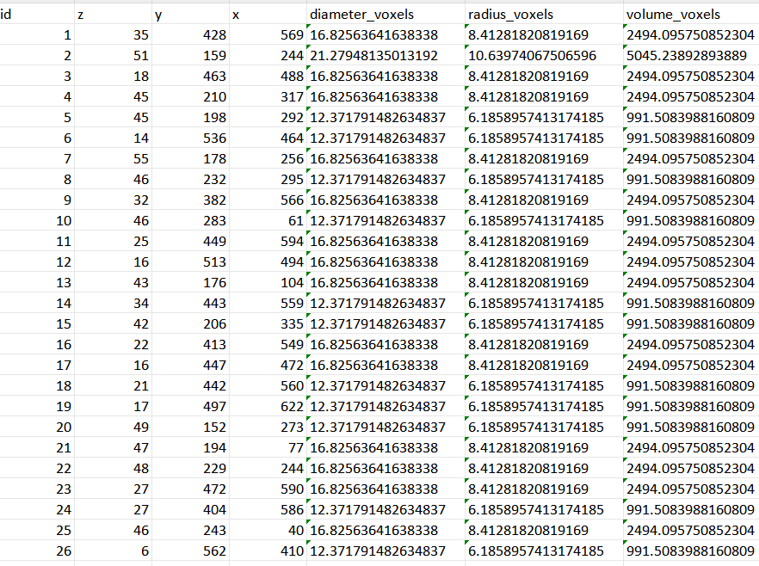
DATASETS(Metrics-lysosomes)
NUMBER OF LYSOSOMES
26

Slide 9
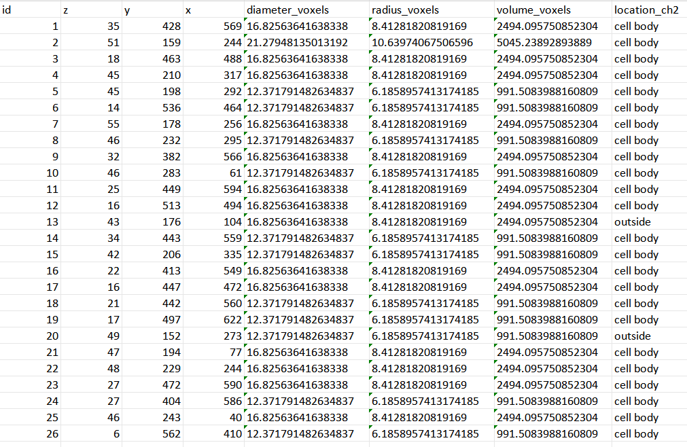

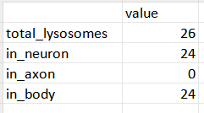
DATASETS(Localization of lysosomes in the cell)

Slide 10
NEXT STAGES
Continue improving cell segmentation.
Continue improving the signal fit to determine the real dimensions of cell bodies, cell axes, and lysosomes.
Converting pixel measurements to nanometers.

Slide 11
Questions?

